Slide 1
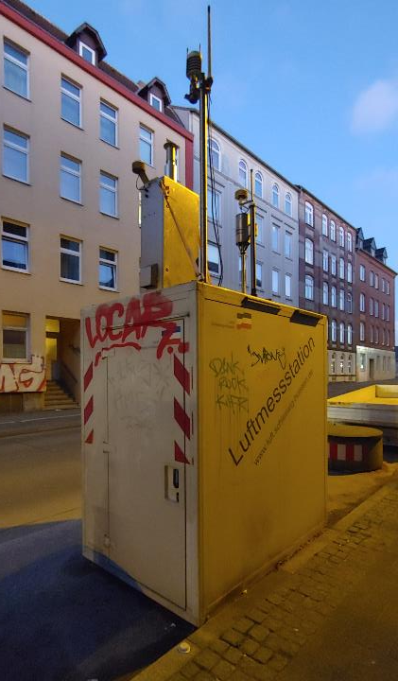
Particulate Matter Pollution (PM10) prediction
Philipp Jordt, Friedrich Kerchnawe, Anke Schürmann

Slide 2

Introduction and motivation
What is PM10?
Particulate matter: diameter ≤ 10 µm
Inhalable particles → Causing health problems
Caused by car pollution, ships, tire wear, road salt,…
Why shall we predict the value?
EU-norm (exception for winter time: road salt): legal limits
24 hour mean: only 35 times above 50 µg/$m^{3}$per year
Mean of a year: 40 µg/$m^{3}$
Which factors influence the PM10 concentration?
Meteorological data
Amount of PM10 produced

Slide 3
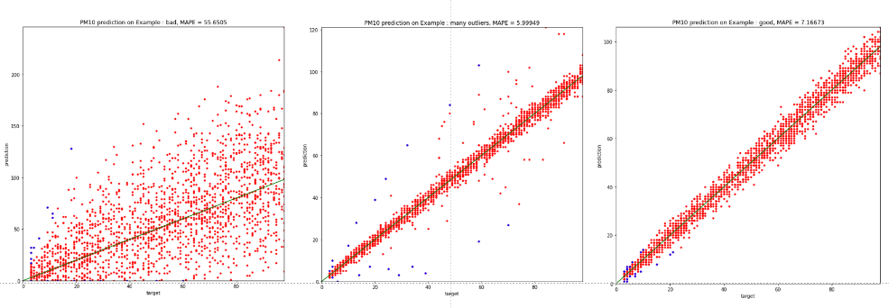
Assessment Criteria
quantitative criterion: MAPE (mean absolute percentage error)
scatter plot: target values versus predictions

Slide 4
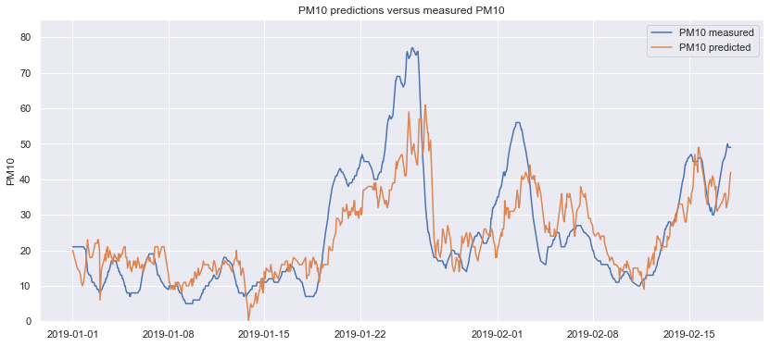
Timeline plot: predictions vs measured values

Slide 5
Factors used for prediction
Weather data:
Wind: direction and intensity
Rain: relative humidity, coverage of clouds, amount of rain
Temperature
Air pressure
Traffic influencing factors:
Day of week
Holidays and school holidays
Trends:
Previous PM10 data
Previous weather data
Date

Slide 6
About the data
Air monitoring station: DESH027_Kiel-Bahnhofstr
Weather station: Kiel Holtenau
Time frame: : 2016-01-01 - 2019-12-31 (pre-corona time)
Measured on hourly basis
All data available for free online on DWD and Umweltbundesamt

Slide 7
Data Analysis
The following section will give a small overview of the data. Different kinds of plots are used to describe certain features of the dataset and to get an idea which factors might influence the PM10 value.
The first plots show the maximal and the minimal PM10 values per day over time. A seasonal trend can be seen: in general the PM10 values are lower in sommer time and high in the beginning of a year.
Since it can be assumed that the wind force might be negatively correlated with the PM10 values. The more windy it is the faster the air gets exchanged and therefore the PM10 value decreases. This can be slightly seen when plotting maximal/minimal PM10 values over time against maximal/minimal wind force over time.

Slide 8
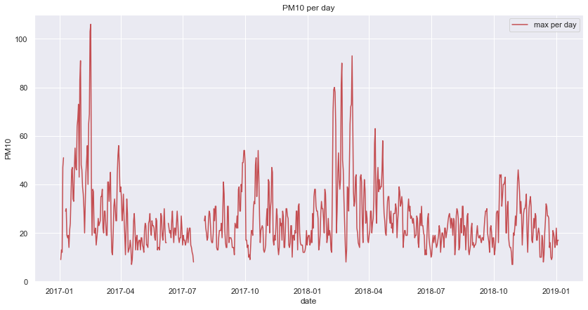
maximal PM10 values per day over time

Slide 9
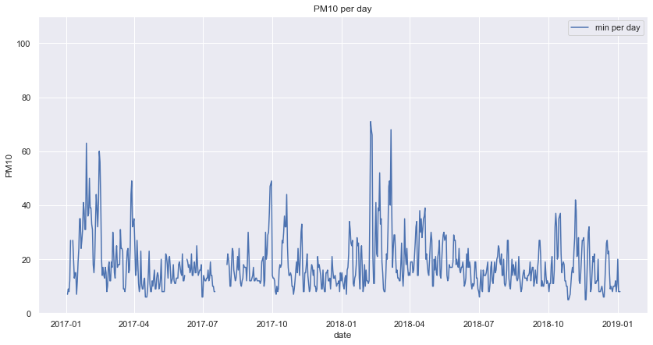
minimal PM10 values per day over time

Slide 10
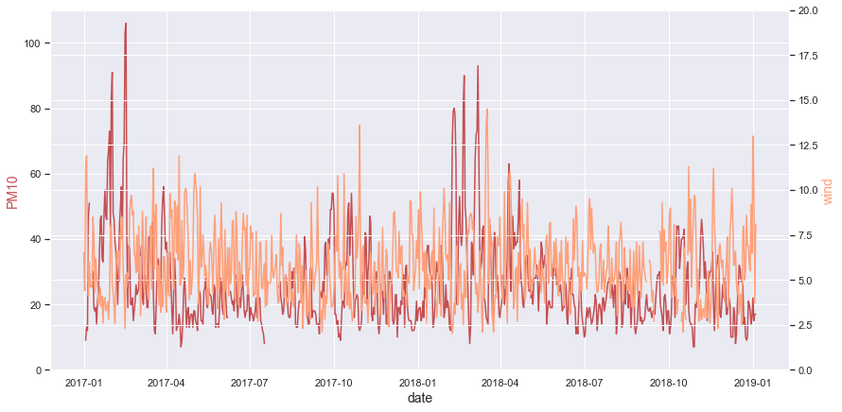
maximal PM10 and wind force per day over time

Slide 11
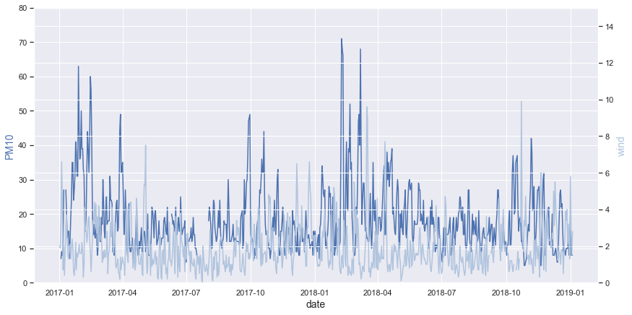
minimal PM10 and wind force per day over time

Slide 12
The following plots will give a closer insight on how the PM10 value changes over time.
Comparing the values of different years it can be seen that the values vary slightly but no clear trend can be seen.
More interesting is the development of PM10 values during the course of the year. Having a look at the monthly distributions it can be seen that it PM10 is higher in winter time. It’s increasing from October until April with its peak in February. After that the values decrease to a lower summer time level.
Another interesting question is whether PM10 values vary by day of week. The values increase from Monday to Thursday. At the end of a week a decrease in values can be seen from Friday to Sunday. This might be due to higher emission on working days.
Comparing hourly values there seems to be no clear effect on PM10 values.

Slide 13
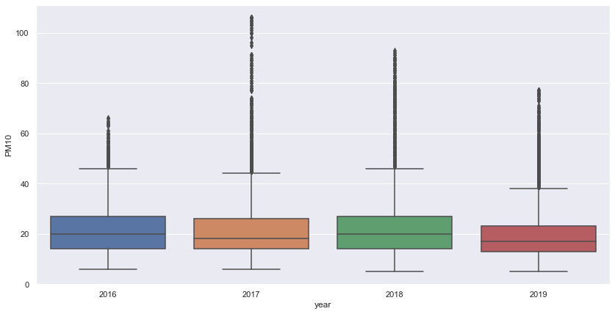
Comparing PM10 values for different years

Slide 14
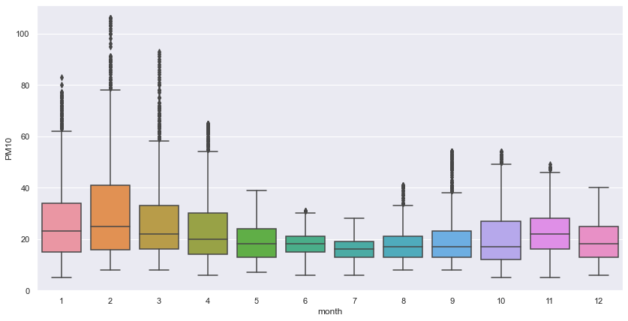
PM10 values during the course of the year

Slide 15
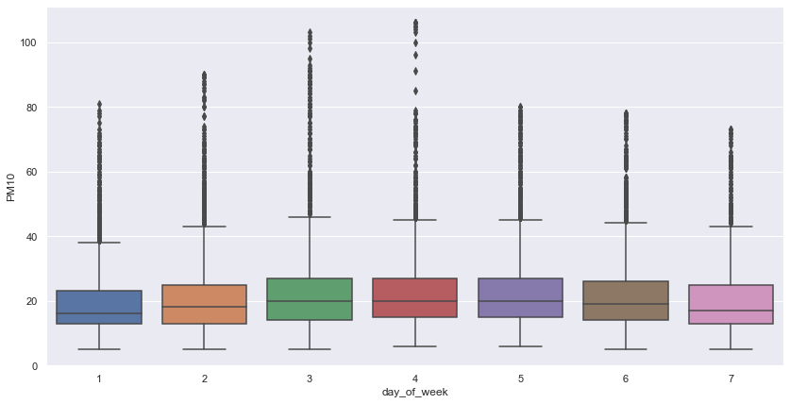
PM10 over the course of the week (from Monday = 1 to Sunday = 7)

Slide 16
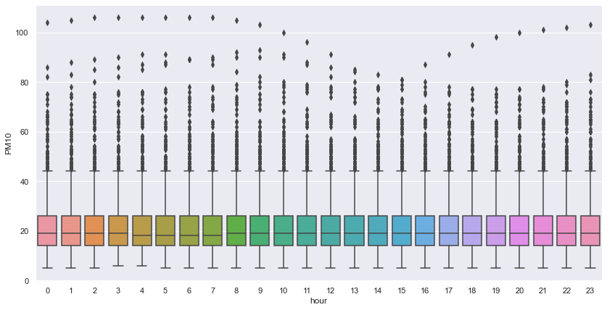
PM10 during the course of a day

Slide 17
The following slides will analyse the correlation between the features used for prediction and the PM10 values.
The correlation matrix shows a negative correlation between wind force and PM10. The more windy it is the faster the air will get exchanged and by that the PM10 in the air will decrease. Hence this negative correlation is in line with theory.
Furthermore there is a negative correlation with temperature.
To further analyse the relationship between PM10 and wind force another boxplot is used. Here the wind force is categorized to Beaufort scale. The values decrease as wind force increases.
Due to small group sizes and rounding issues defining boundaries of category 0, the results for this category might not be representative. For a general trend see categories 1 to 6.

Slide 18
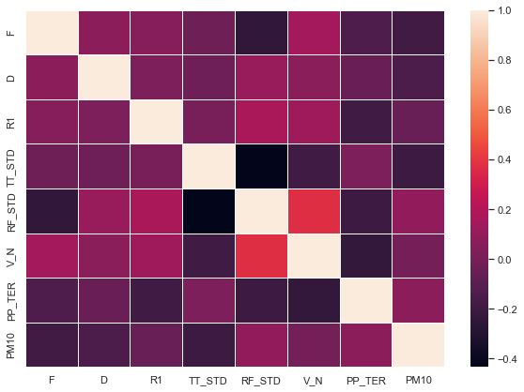
Column Description
F wind velocity (in m/sec)
D wind direction (in deg)
R1 rain amount per hour (in mm)
TT_STD air temperature at 2m height (in °C)
RF_STD relative humidity (in %)
V_N degree of coverage of all clouds (in eights)
PP_TER air pressure (in hpa)
Correlation between weather features and PM10 values

Slide 19
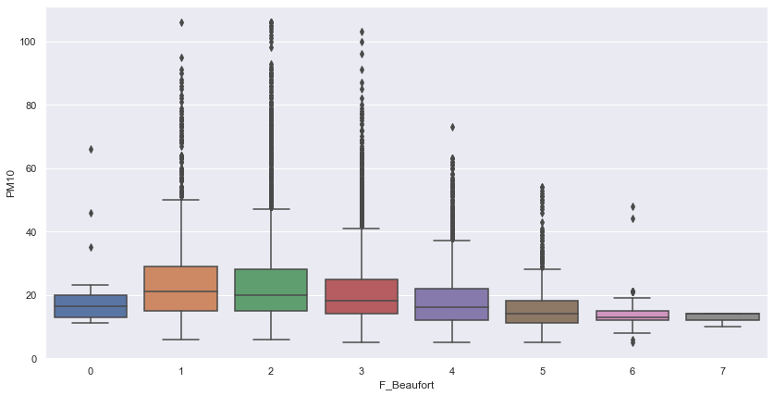
PM10 by wind force in Beaufort

Slide 20
The following slides will give an overview about missing values in our dataset and a short summary for the different features.
To decide how to deal with missing data it is decisive whether the data is missing at random or whether there is a systematic reason behind it. To check this we plotted the missing values per feature over time.
Some features like air pressure and coverage with cloudes are having a lot of missing values. For all the other features there are a moderate number of missing values included.
Furthermore a table summarizing the different features is given to get an overview.

Slide 21
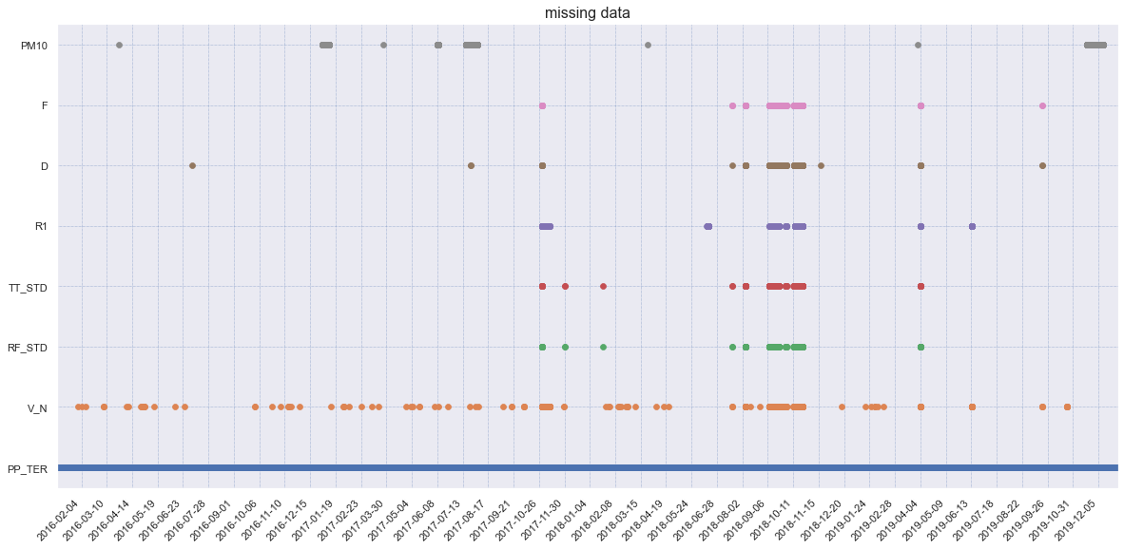

Missing data

Slide 22
 | features | unique_values | min | max | NaNs | mean | mode
0 | Datum | 35064 | 2016-01-01 00:00:00 | 2019-12-31 23:00:00 | 0 | 2017-12-31 11:30:00 | 2016-01-01 00:00:00
1 | PM10 | 99 | 5.0 | 106.0 | 1096 | 21.415538 | 13.0
2 | F | 141 | 0.0 | 14.5 | 431 | 3.75012 | 2.4
3 | D | 36 | 10.0 | 360.0 | 420 | 196.832641 | 260.0
4 | R1 | 79 | 0.0 | 25.9 | 580 | 0.082859 | 0.0
5 | TT_STD | 413 | -9.2 | 34.4 | 428 | 9.998455 | 6.1
6 | RF_STD | 699 | 16.3 | 100.0 | 428 | 81.11357 | 100.0
7 | V_N | 9 | 0.0 | 8.0 | 793 | 5.035161 | 8.0
8 | PP_TER | 558 | 974.4 | 1039.6 | 29775 | 1011.015069 | 1012.0
summary of the features

Slide 23
Data preparation
Missing data: forward fill or drop
Divide Date into year, month, day, hour
Special treatment:
Wind directions: encode from main directions to degree
Change unobserved values to NaN
One-Hot Encoding:
Month
Day of week
Hour
Wind direction
Bank holidays

Slide 24
Next step
This presentation only covers the first part of the project. For the programming part continue by checking out PM10_project_1.ipynb and after that PM10_project_2.ipynb

